Slide 1
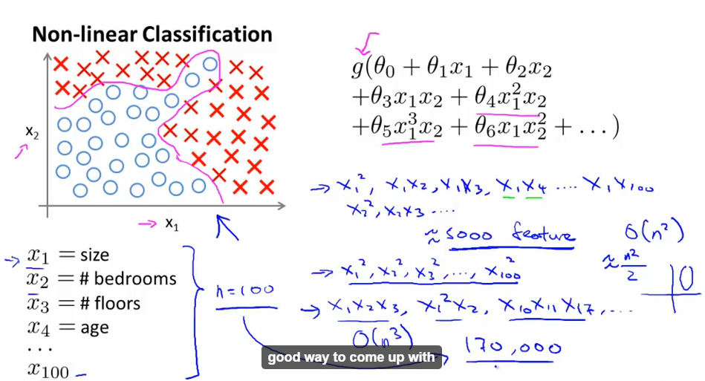
Neural Networks : Representation Non-linear hypothesis
What are the odds that your houses will be sold within the next 6 months?

Slide 2
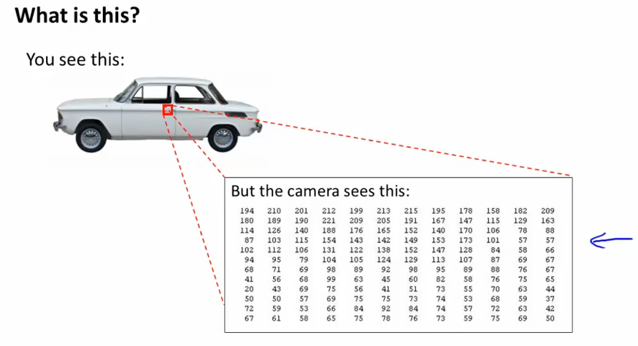

Slide 3
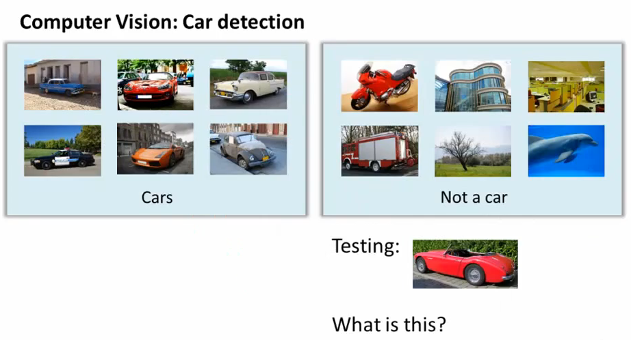

Slide 4
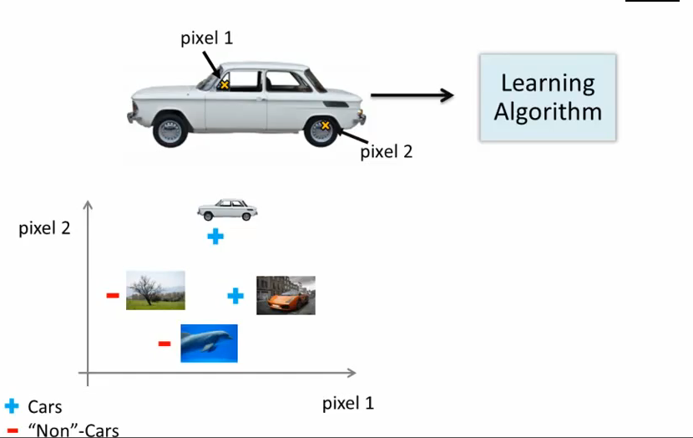

Slide 5
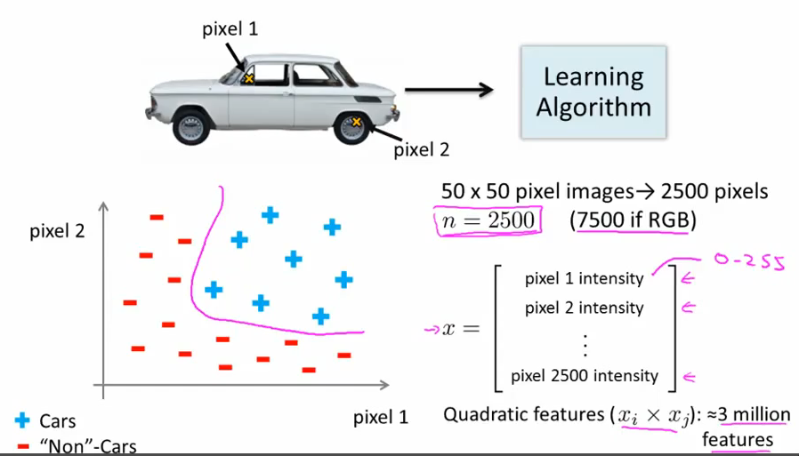

Slide 6
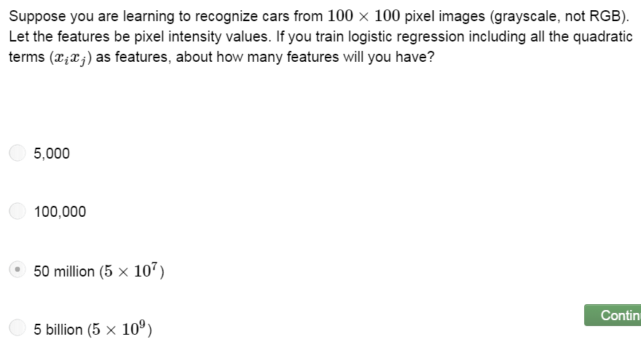

Slide 7
So simple logistic regression together with adding in maybe the quadratic or the cubic features that’s not just a good way to learn complex non-linear hypothesis when n is large because you just end up with too many features. So I’ll tell you neural network which turns out much better way to learn complex hypothesis, complex non-linear hypothesis even when your features space and n is large.

Slide 8
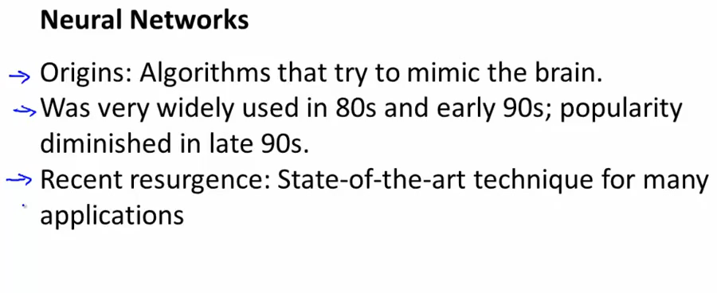
Neural network and brain

Slide 9
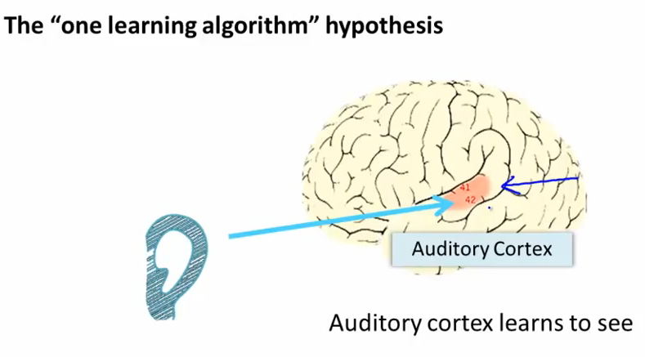

Slide 10
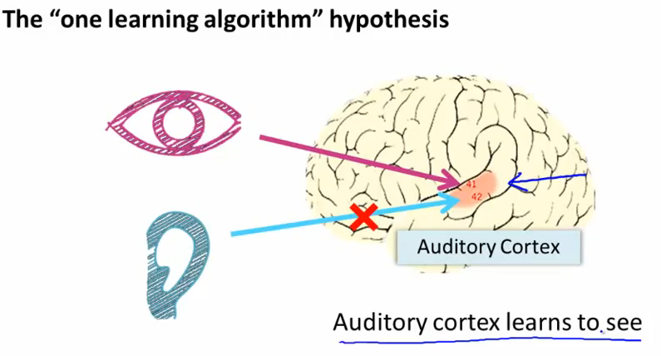

Slide 11
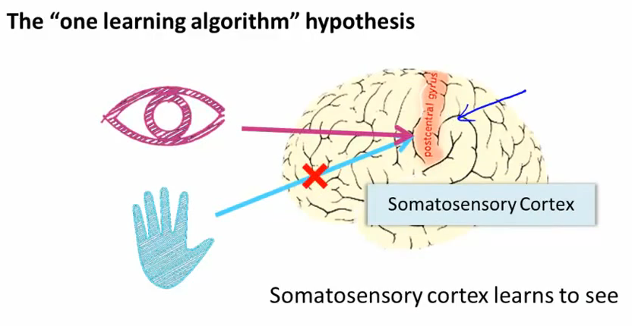

Slide 12
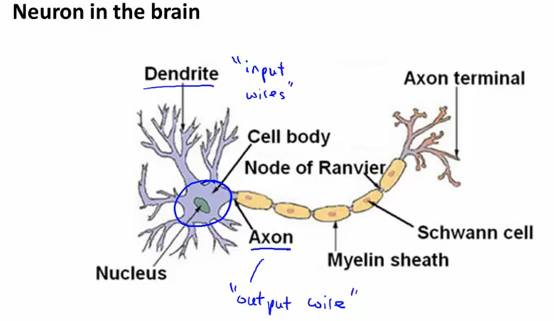
Model representation I

Slide 13
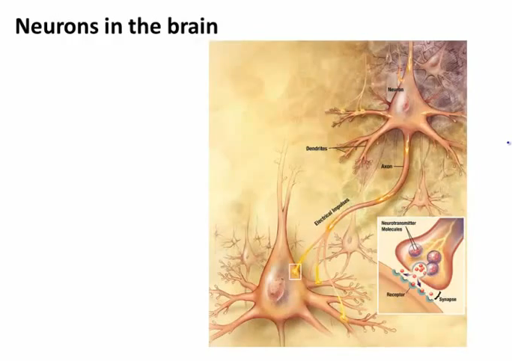

Slide 14
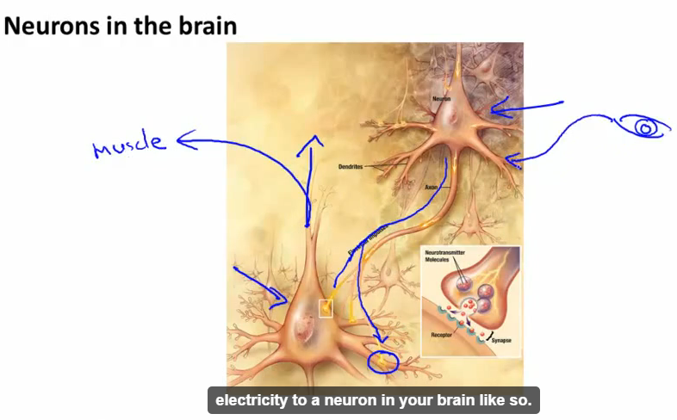

Slide 15
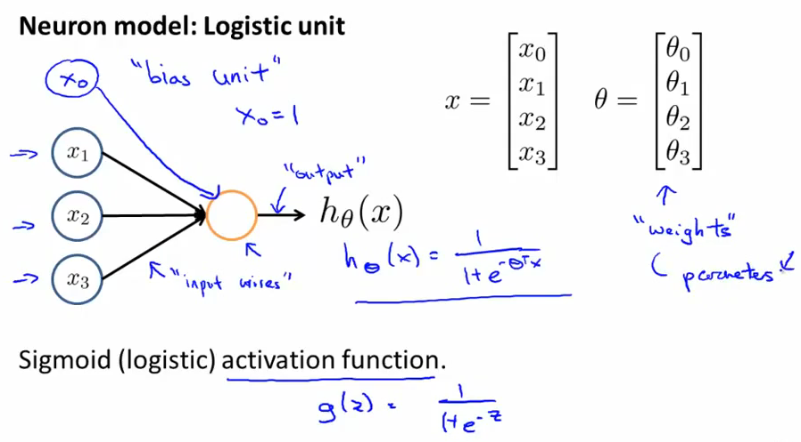
We are going to model a neuron as a logistic unit.
When we talk about neural networks, sometimes we’ll say that this is an artificial neuron with a sigmoid or a logistic activation function. So activation function in the terminology is the term for that function g(z). Weights is the parameters of the model.

Slide 16
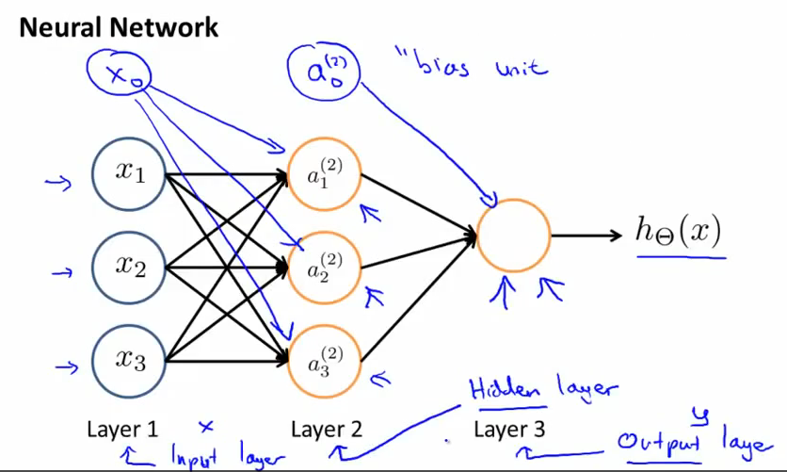
In supervised learning, you could see the input, and you could see the correct outputs. Whereas the hidden layer are values you don’t get to observe in the training set, it is not x nor y, so it’s called hidden.

Slide 17
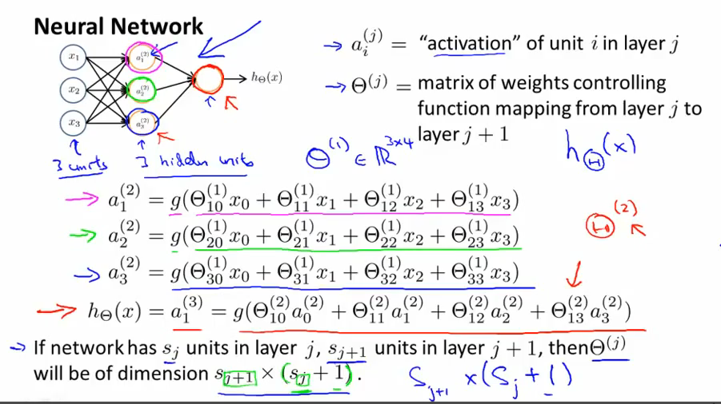

Slide 18
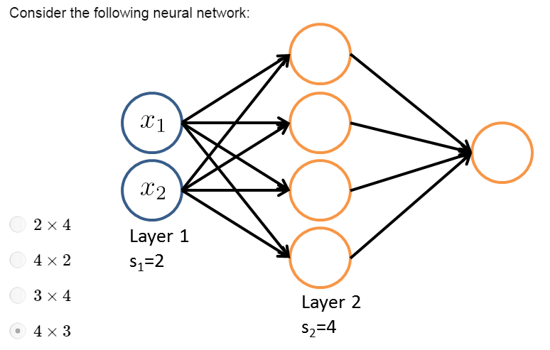

Slide 19
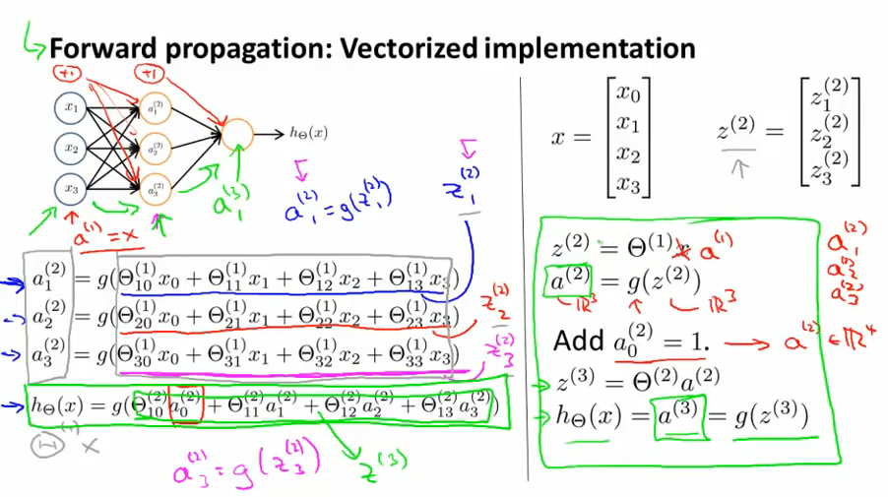
Model presentation II
The process of computing the activation from the input layer, then the hidden layer, then the output layer, that’s called forward propagation, what we will do is just worked out a vectored implementation of the procedure.

Slide 20
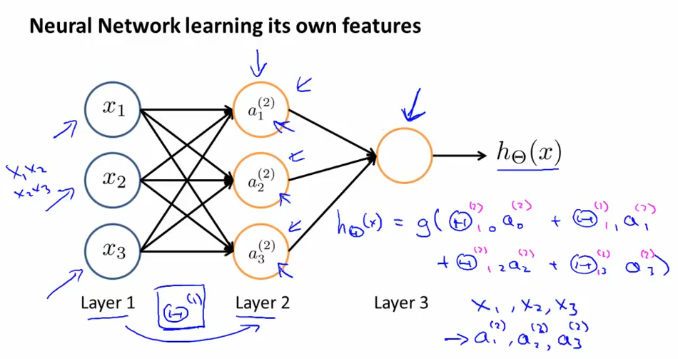

Slide 21
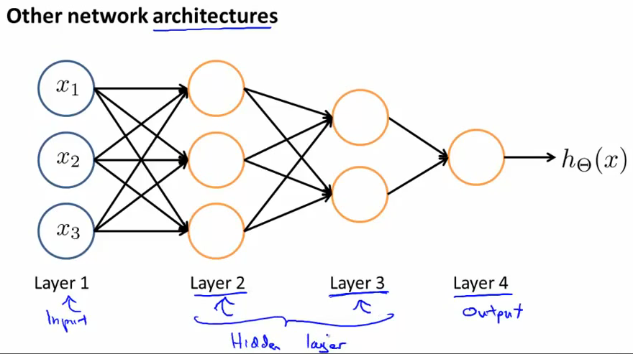
The way that neural networks are connected, that’s called architecture. So the term architecture refers to how the different neurons are connected to each other.

Slide 22
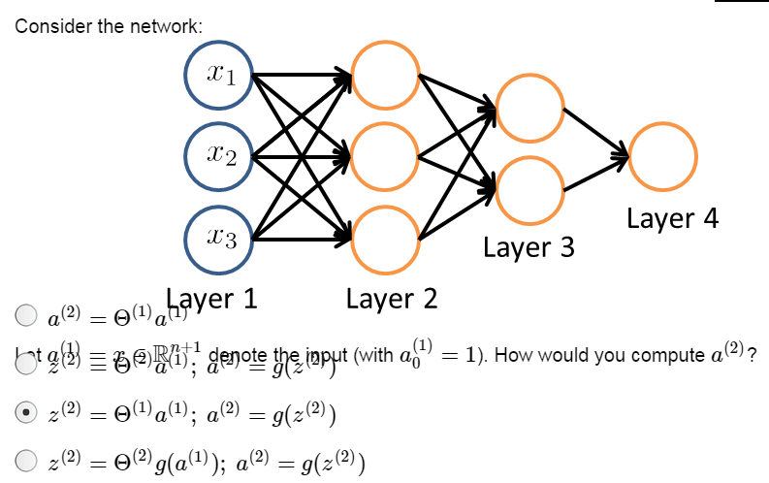

Slide 23
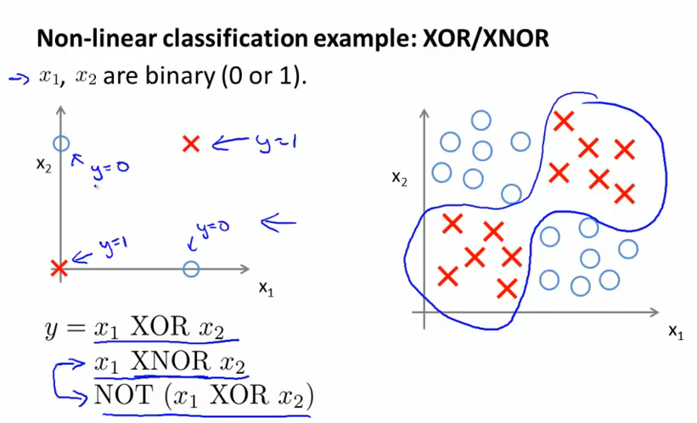
Examples and Intuitions I

Slide 24
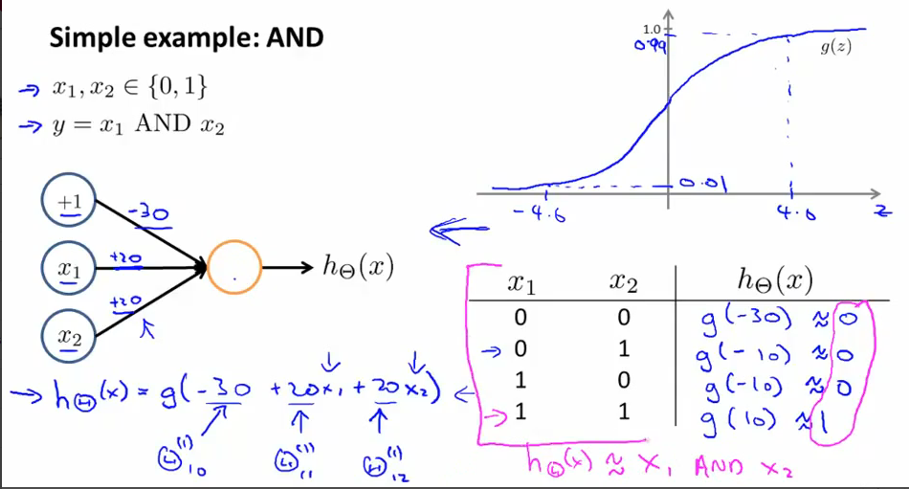

Slide 25
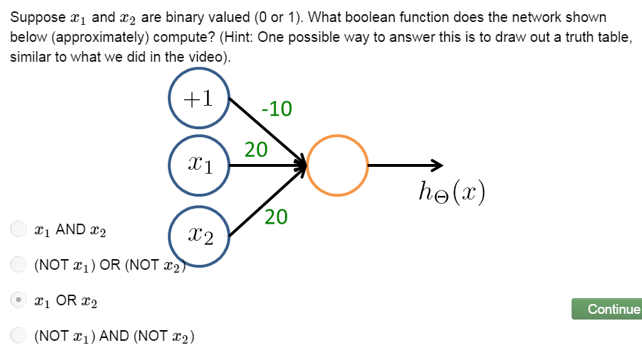

Slide 26
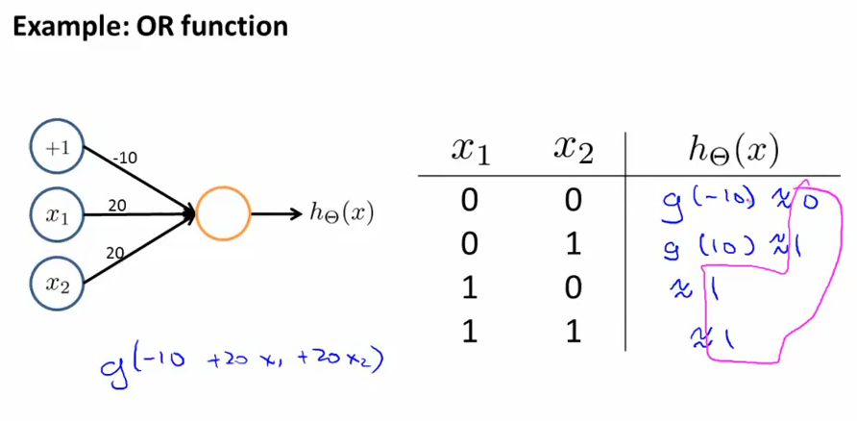

Slide 27
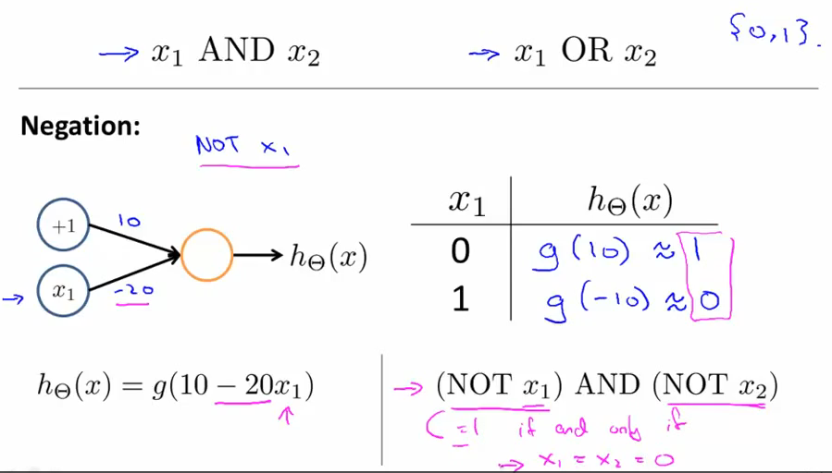
Examples and Intuitions II

Slide 28
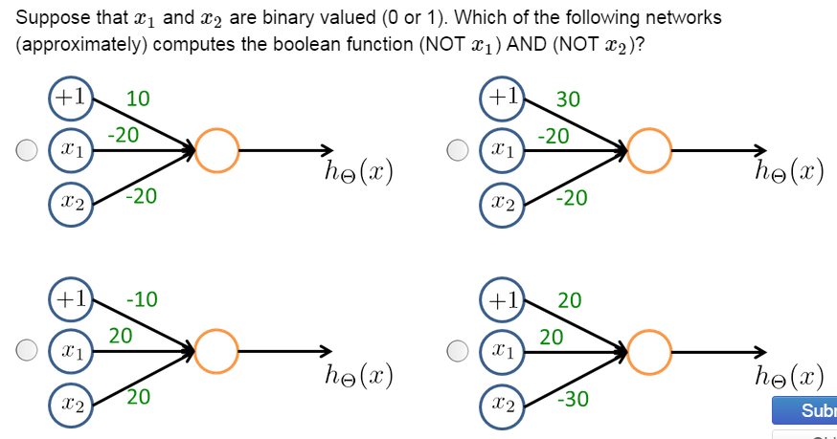

Slide 29
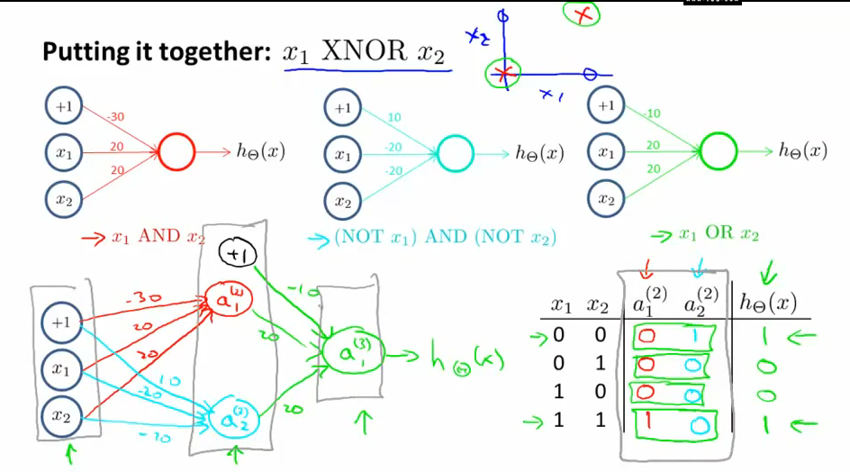

Slide 30
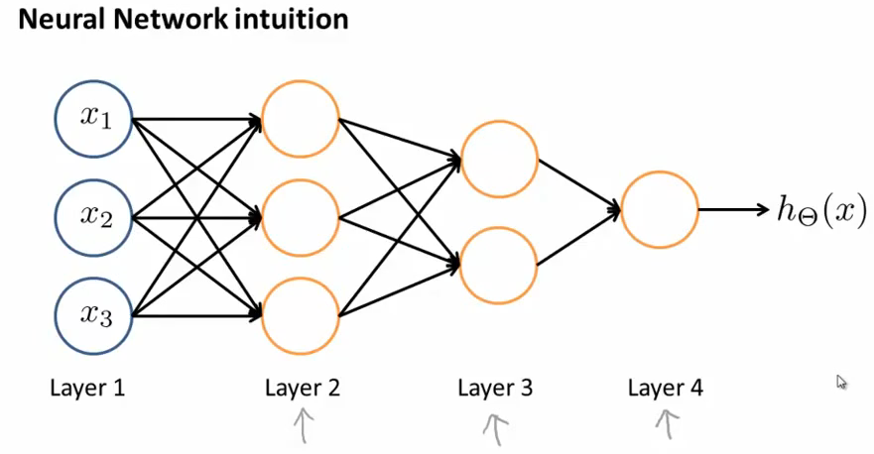

Slide 31
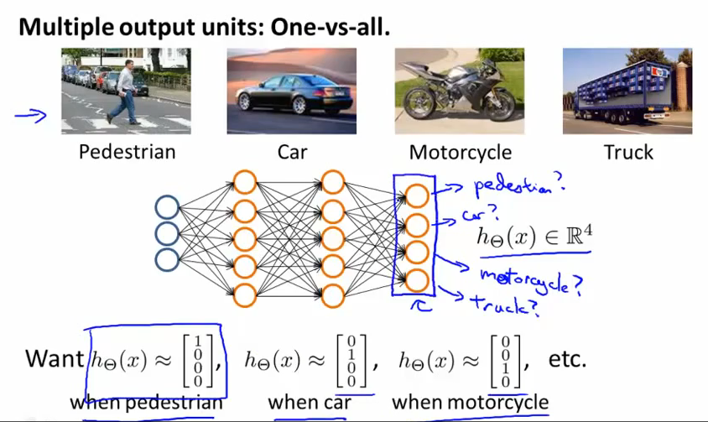
Multi-class classification

Slide 32
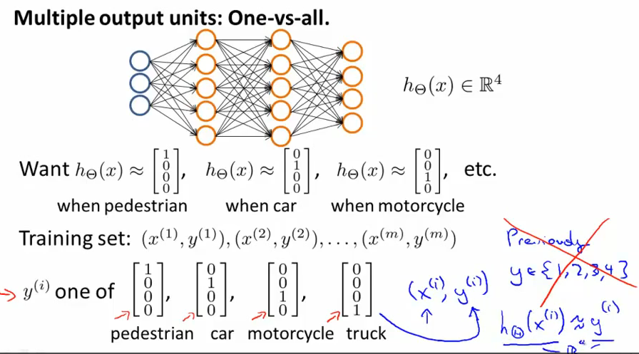

Slide 33
